Slide 1

LECTURE 3_WRITING

Slide 2
Writing Questions 1-5
Five photos.
Will be given two words for each photo => write a sentence
Eight minutes to complete
Click on
“Next”: move to the next photo
“Back”: go back to previous photos
Your ability to write grammatically correct sentences relevant to the photos will be scored.

Slide 3
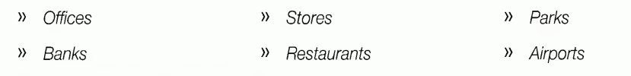
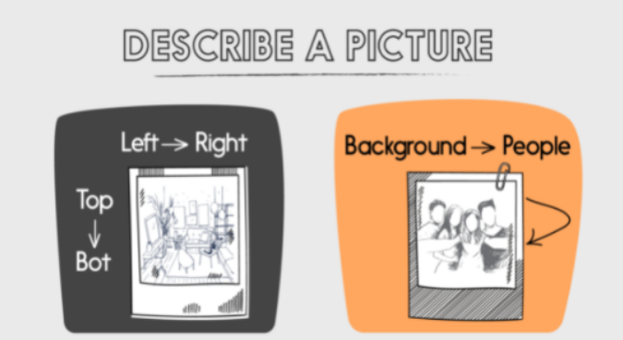
The photos will depict common everyday scenes in places such as:

Slide 4
QUICK GUIDE: Write a Sentence Based on a Picture
Definition | Test ability to write meaningful sentences using correct grammar.
Targeted Skills | • use correct word order. • write sentences with one clause or two clauses. • use adjectives, adverbs, and prepositions correctly. • use subordinating conjunctions correctly. • write sentences that are relevant to the photos.
Question Types | You will be given a pair of words for each photo. The two words will be some combination of the following: • Noun • Preposition • Verb • Coordinating conjunction • Adjective • Subordinating conjunction • Adverb

Slide 5
A Good Response | A good response uses the two provided words correctly in terms of both grammatical structure and word meaning and is relevant to the photo.
Things to Remember | Begin by thinking about how you can use the two words to describe something in the photo Decide what your subject and main verb will be. Nouns will always be provided in the singular form, and verbs will always be provided in the base form. You can change these forms if you want.

Slide 6
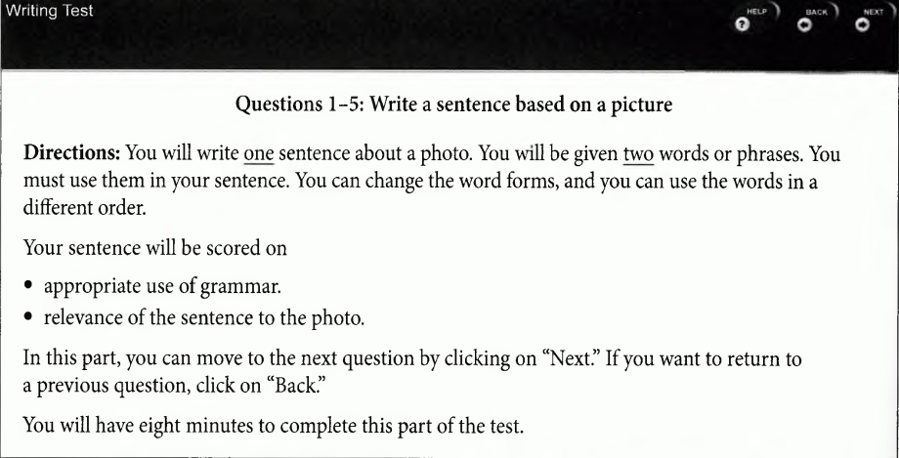
WALK THROUGH: Write a Sentence Based on a Picture
A What You’ll See
For Questions 1-5, you will see the directions, and you will see a photo and two words on the screen. Look at the sample. Think about how you can use the words to describe something about the photos.

Slide 7
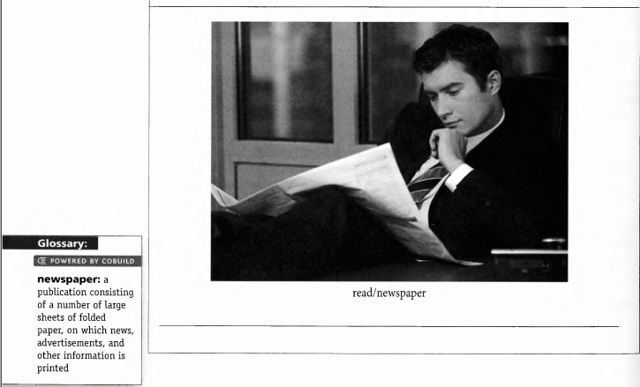
C. PRACTICE

Slide 8
B What You’ll Do
Now, write a sentence for the photo in Part A using the word pairs given. Then look at the sample response. Notice that the grammar is correct, the response is relevant to the photo, and it uses both of the words provided.
SAMPLE RESPONSE ► The man is reading the newspaper

Slide 9
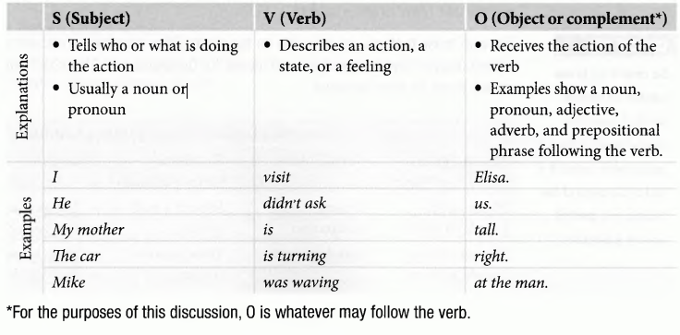
GET IT RIGHT: Tips and Tasks for Answering Correctly
GRAMMAR AND VOCABULARY
Be able to write sentences that are grammatical, coherent, and relevant to the photo.
Familiarize yourself with the basic grammar and vocabulary points
» TIP 1 Learn the basics of good sentence-writing in English.
The S-V-0 pattern (subject-verb-object).

Slide 10
TIP 2 Use correct capitalization and punctuation.
To write a good sentence that is easy to understand, you need to use capitalization and punctuation correctly.
Capitalization refers to the use of capital letters.
All sentences in English begin with a capital letter.
The English language also uses capital letters to begin all proper nouns.
Names of people
Companies
Languages
Places
Months
Day
Titles
• Mary Smith • Tuesday, June 3 • Fox Theater
• IBM • Dr. Evans, Mr. Smith • Miami, Florida, USA
Punctuation refers to the symbols
periods (.)
question marks (?)
commas (,)

Slide 11
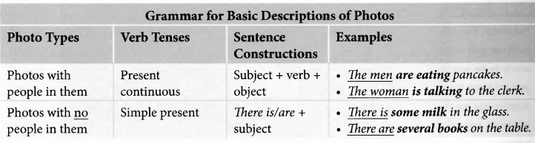
TIP 3 Know the basic grammar features to use in your sentences
Choose the right sentence structure and verb tense.
In most cases, you will be able to use the basic S-V-0 structure with the present continuous tense.
However, in some cases, you will use There is/are + subject.
The verb tense that you use depends on the photo.

Slide 12
Using Function Words
» TIP Familiarize yourself with function words.
Function Word Types | Usage | Examples
Coordinating Conjunctions and, but, or, yet, for, nor, so | • Connect two clauses • Ideas connected by the conjunction receive equal emphasis | • Teresa enjoys watching movies, and she enjoys reading books. • I ’ll order either the soup or the salad
Subordinating Conjunctions Time / location: after, before, since, when, while, until, where, wherever Cause / effect: because, since, so that, why Contrast: whereas, although Similarity: like, just as Condition: if, unless, until, in case, as if, as though, provided that | • Connect an independent clause and a dependent clause • Express the relationship between two clauses • Idea in the first clause more important than the idea in the second clause | • After she bought the ticket, she boarded the train. • Elisa studies because she wants a good grade. • Unless he takes his medicine, Jack will not feel better.

Slide 13
Correlative Conjunctions both . . . and; not only. . . but also; not. . . but; either. . . or; neither. . . nor; whether. . . or; as . . . as | • Connect two ideas • Ideas receive equal emphasis • Second noun must agree with the verb that follows | • Connect two ideas • Ideas receive equal emphasis • Second noun must agree with the verb that follows
Non-Location Prepositions | • Don’t indicate location • Often part of phrasal verbs • Often idiomatic, so they must be memorized | • He goes to work by bus. • Ellen must turn in the project on Monday. • They should pay for it at the register.
Intensifiers very, too much/many, quite, rather, so | • Typically modify adverbs and adjectives • Make the meaning of the words they modify stronger | • She is very happy with the results. • It is quite cold there. • The ferry is traveling rather slowly.

Slide 14
HOMEWORK
https://www.jaimeselwood.com/uploads/2/6/6/7/26678157/toeic__writing_practice_test_2018.pdf
https://www.englishclub.com/esl-exams/ets-toeic-practice-writing.php
https://www.examenglish.com/TOEIC/TOEIC_writing_part1_sample_test.htm

